Slide 1


Robotbuilder & Command Based Robot
Team 3244

Slide 2
Robotbuilder & Command Based Robot
About Us
Corey Applegate
20 Years Industrial Controls Technician using Rockwell Automation PLC and Motion Control, Kuka Robotics, Fanuc Robotics
4 years Mentoring a LEGO Mindstorms Club for 5-6 graders
1 season Mentoring VEX
1st full year with FIRST was 2016 Stronghold
Hobbies and skills include
3d Printing, Autodesk Inventor, Raspberry Pi, Arduino
Austin Applegate
Junior Tech High School
1st Year FIRST Stronghold
Team responsibilities
Driver, Build, Some Software
Hobbies
PC builds and Gaming, Football
Team 3244

Slide 3
Robotbuilder & Command Based Robot
What we hope to cover
Quickly create the backbone of the robot code Using RobotBuilder
Import project into Eclipse
Explore the parts of the Project
Test robot IO
without writing a single line of code
Create commands
link Joystick inputs to Subsystems
Create Methods in Subsystems
for the Commands to use
Test/Tune a PID Subsystem
again without writing a single line of code
Link the setpoints of this PID subsystem to buttons
Add User code to control the Drivetrain
Team 3244

Slide 4
Robotbuilder & Command Based Robot
Pros and Cons to Command Based programing
Pros
Can develop and debug subsystems individually
Easily create a more complex autonomous using command groups
Well organized code (Starting with Robotbuilder)
Easily split functions or subsystem coding responsibilities between multiple students
Reuse commands in both Auto and Teleop
Cons
Looks complicated because there are so many files to create for operator IO, Robot IO, Subsystems, Commands
Must treat some hardware differently such as limit switches and avoid loops and waits
Must link and create objects in correct order to avoid errors
Team 3244

Slide 5
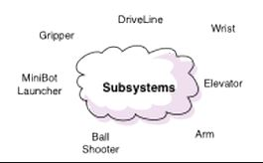
Robotbuilder & Command Based Robot
Parts of a Command Based Robot Program
SUBSYSTEMS
Different subsets of the robot. IE Drivetrain, manipulators, vision
http://wpilib.screenstepslive.com/s/4485/m/13810/l/241892-what-is-command-based-programming
Team 3244
Notes:
We will explore these files latter on

Slide 6
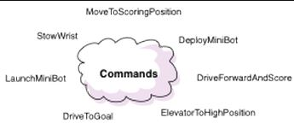
Robotbuilder & Command Based Robot
Parts of a Command Based Robot Program
COMMANDS
What do you want your subsystem to do?
http://wpilib.screenstepslive.com/s/4485/m/13810/l/241892-what-is-command-based-programming
Team 3244
Notes:
We will explore these files latter on

Slide 7
Robotbuilder & Command Based Robot
Parts of a Command Based Robot Program
Robot
Main program
OI
All Joystick controls created and assigned functionality
Smartdashboard Buttons
RobotMap
Maps all Robot Inputs and Outputs Plugged into the RoboRio
Team 3244
Notes:
We will explore these files latter on

Slide 8
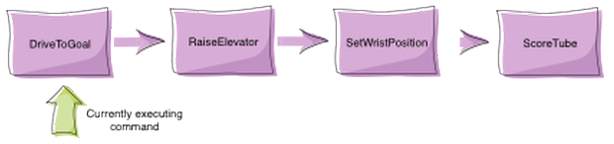
Robotbuilder & Command Based Robot
How Commands work
Commands let you break up the tasks of operating the robot into small chunks.
Each command has an execute() method that does some work and an isFinished() method that tells if it is done.
http://wpilib.screenstepslive.com/s/4485/m/13810/l/241892-what-is-command-based-programming
Team 3244
Notes:
We will explore these files latter on

Slide 9
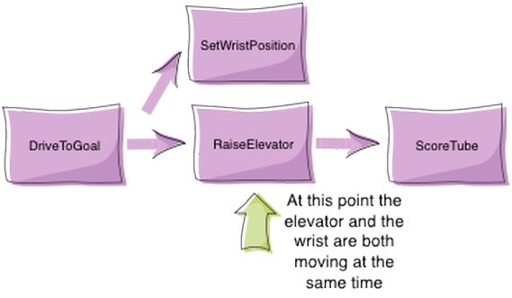
Robotbuilder & Command Based Robot
Concurrency
Sometimes it is desirable to have several operations happening concurrently. In the previous example you might want to set the wrist position while the elevator is moving up. In this case a command group can start a parallel command (or command group) running.
Team 3244
http://wpilib.screenstepslive.com/s/4485/m/13810/l/241892-what-is-command-based-programming
Notes:
We will explore these files latter on

Slide 10
Robotbuilder & Command Based Robot
How is Robotbuilder going to help us?
Menus and GUI’s to build our subsystems and assign hardware to these systems
Error checking to be sure required components are added to special types of systems or commands
Drop menus populate with only valid options for component
Creates all the associations and many useful code entries for all devices attached to the robot.
Without a line of code written we can test components connected to the robot
Create a wire map for the Electricians.
Team 3244

Slide 11
Robotbuilder & Command Based Robot
Start Eclipse and open Robot builder
Start Live Demo
There are a few set up steps before robot Programing
Team 3244

Slide 12
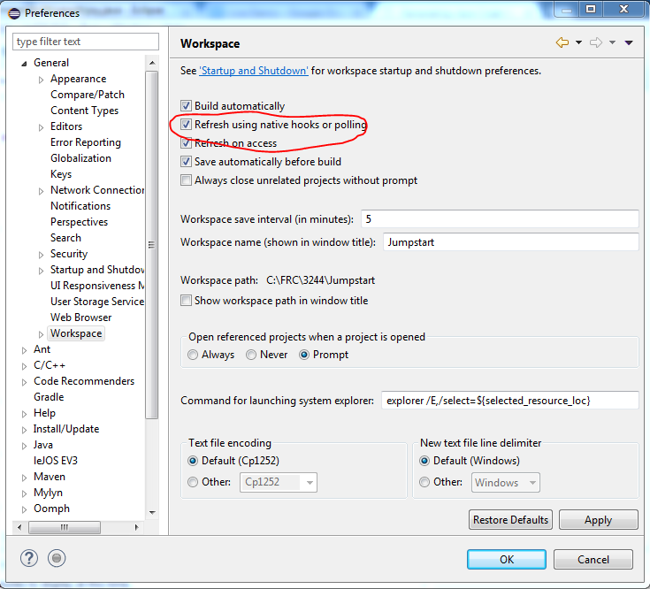
Robotbuilder & Command Based Robot
Live Demo
Start Eclipse
After installing Eclipse per the Wpilib.Screenstepslive instuctions a new setting must be set.
Windows>Preferences>General>Workspace
This setting will allow Eclipse to refresh automatically each time you return to Robotbuilder to add or
change settings after the initial project import.
Team 3244

Slide 13
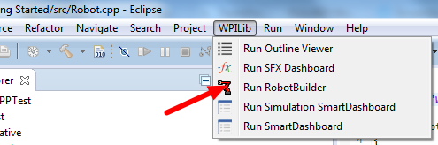
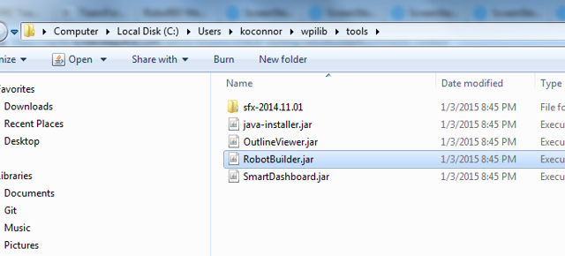
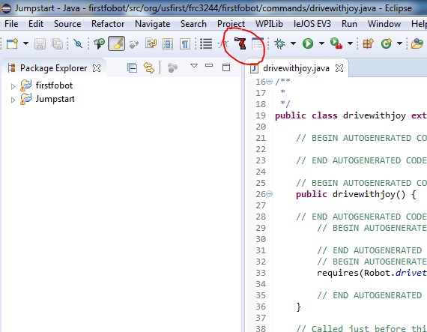
Robotbuilder & Command Based Robot
Live Demo
Start Robotbuilder Tool
Team 3244

Slide 14
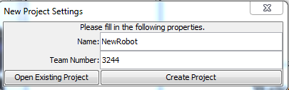
Robotbuilder & Command Based Robot
Live Demo
Start a New Project
Fill in Name and Team Number
Team 3244

Slide 15
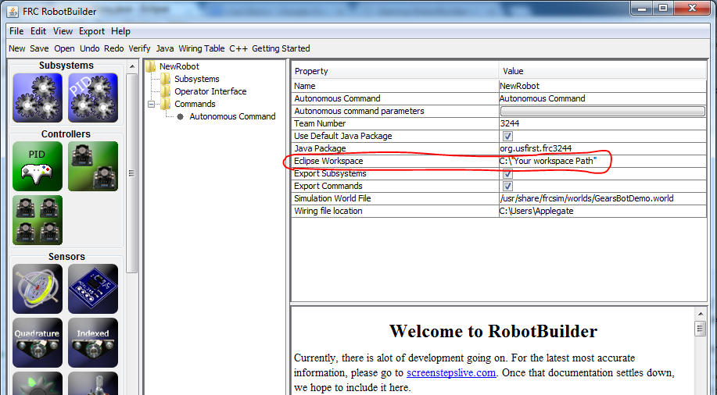
Robotbuilder & Command Based Robot
Live Demo
Complete the Eclipse Workspace location
Team 3244

Slide 16
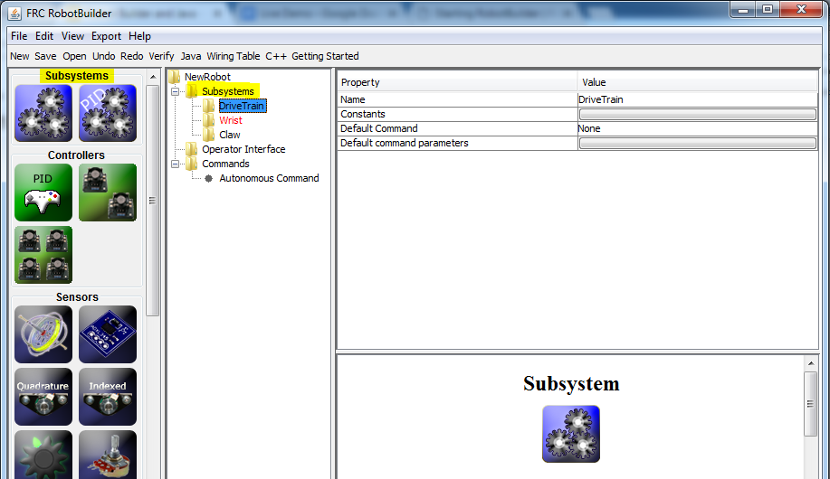
Robotbuilder & Command Based Robot
Live Demo
Divide Robot into Subsystems
Subsystem 1
Standard Type “Drivetrain”
Subsystem 2
PID Type “Wrist”
….
Team 3244

Slide 17
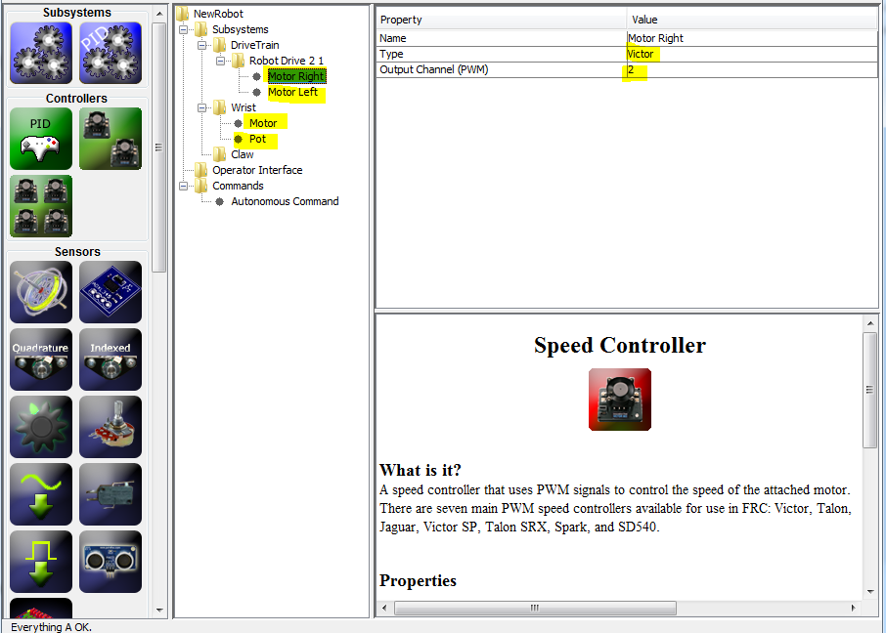
Robotbuilder & Command Based Robot
Live Demo
Add Actuators and Sensors
Add Actuators to Subsystems by either dragging into the workspace from the sidebar or right click menu
Speed Controller select Type and PWM Port
CAN Speed Controllers Have their own icon.
Add Sensors the same way
Set DIO/Analog Channels.
Set other special setting per device type.
Team 3244

Slide 18
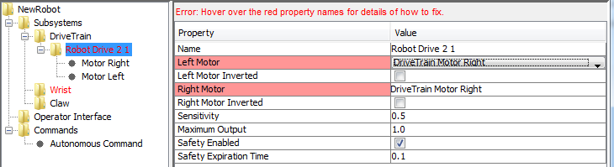
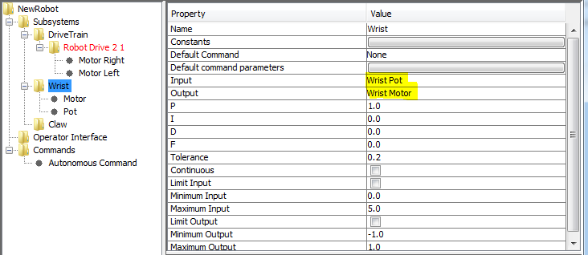
Robotbuilder & Command Based Robot
Live Demo
Correct Red Highlighted Errors
Robot Drive will alway Prefill with the first Speed Controller. You will need to Manually select in drop downs
PID Type Subsystems require a Speed Controller and an input. Analog or Encoder
Team 3244

Slide 19
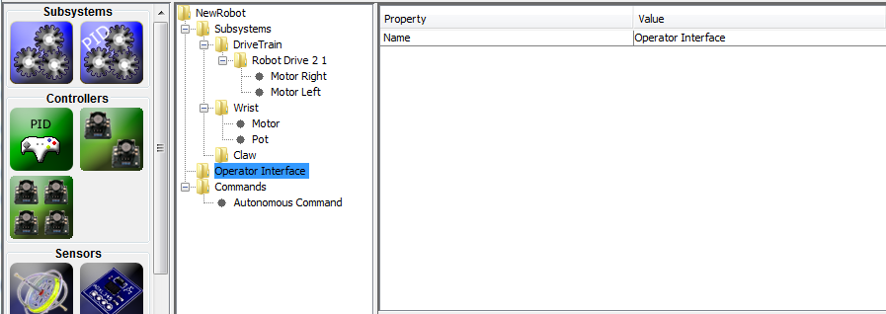
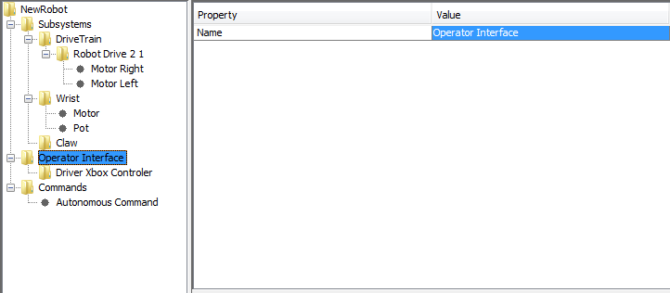
Robotbuilder & Command Based Robot
Live Demo
Add Operator Interface
Drag or right click Operator Interface and add Joystick
Name Joystick
Set Device ID
Team 3244

Slide 20
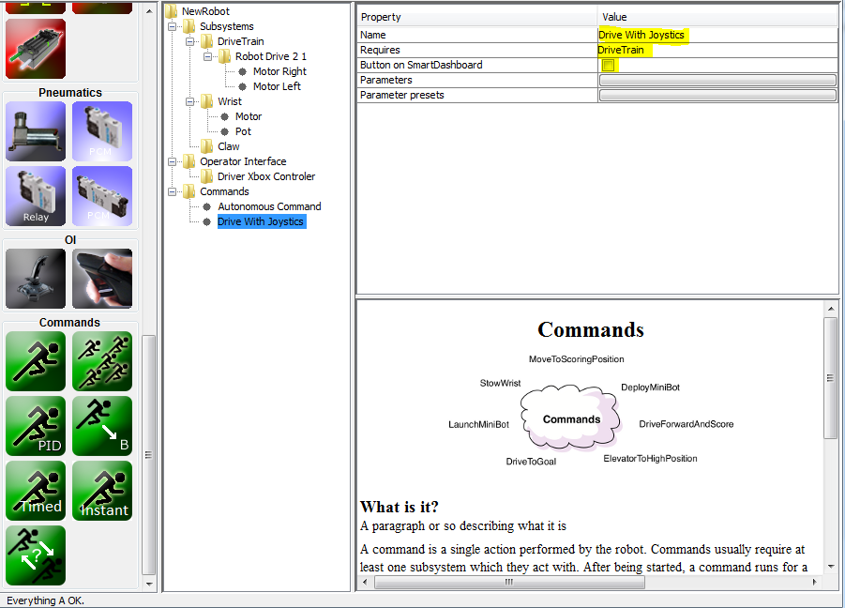
Robotbuilder & Command Based Robot
Live Demo
Create a Command
Right Click Commands or drag in from tools a simple command.
Name Command. Use a good Descriptive title to identify its intentions. *I like to start the name with the sub system
Set the Requires to the Subsytem this command is going to use.
Uncheck Button on SmartDashboard if you DO NOT wish to see this command on driverstation
Team 3244

Slide 21
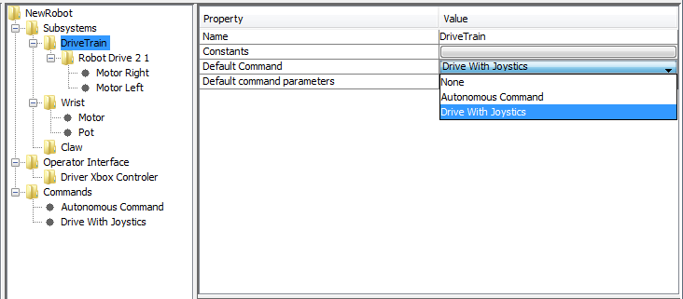
Robotbuilder & Command Based Robot
Live Demo
With Command Created Set Subsystem default Command
This will be the command that runs if no other commands is using this subsystem.
Team 3244

Slide 22
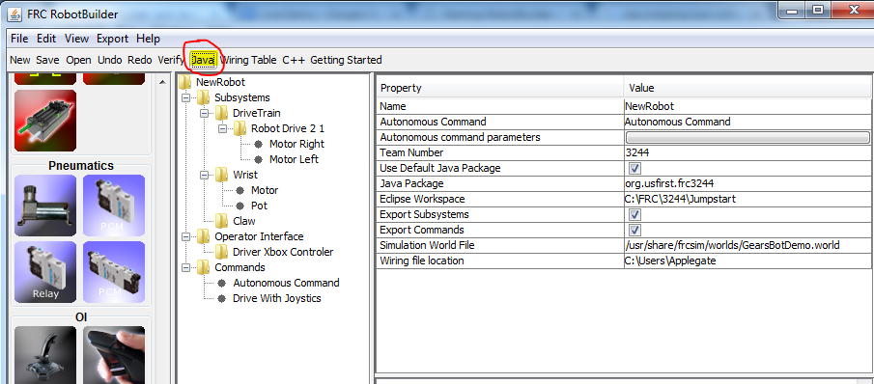
Robotbuilder & Command Based Robot
Live Demo
Save and generate Java Code
Save Project using standard windows steps
Make sure the Eclipse Workspace is set
Click Java Button
Team 3244

Slide 23
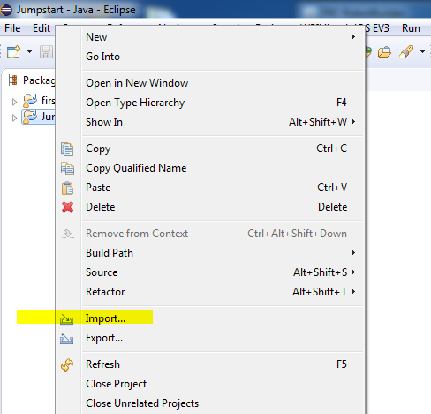
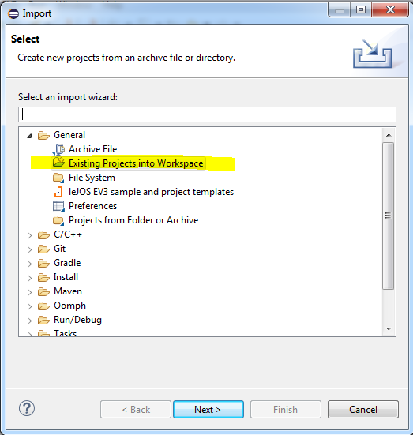
Robotbuilder & Command Based Robot
Live Demo
Import Robotbuilder code into Eclipse
Click “File” or right click “Package Explorer” and select Import…
Select “Existing Projects into Workspace” then “Next”
Team 3244

Slide 24
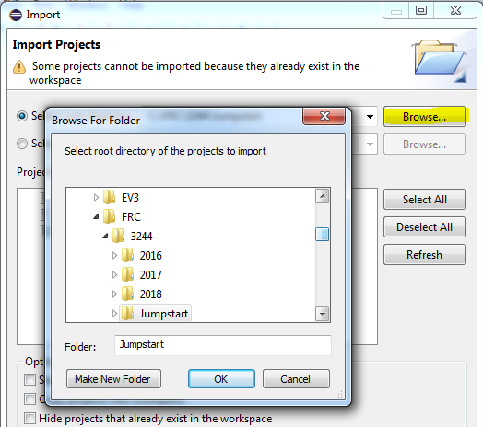
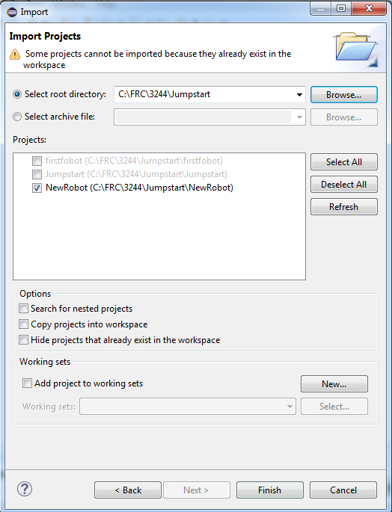
Robotbuilder & Command Based Robot
Live Demo
Import Robotbuilder code into Eclipse
Browse for the Eclipse Workspace set in Robotbuilder. This should the current folder and already selected. Click “OK”
Check the Project and click “Finish”
Team 3244

Slide 25
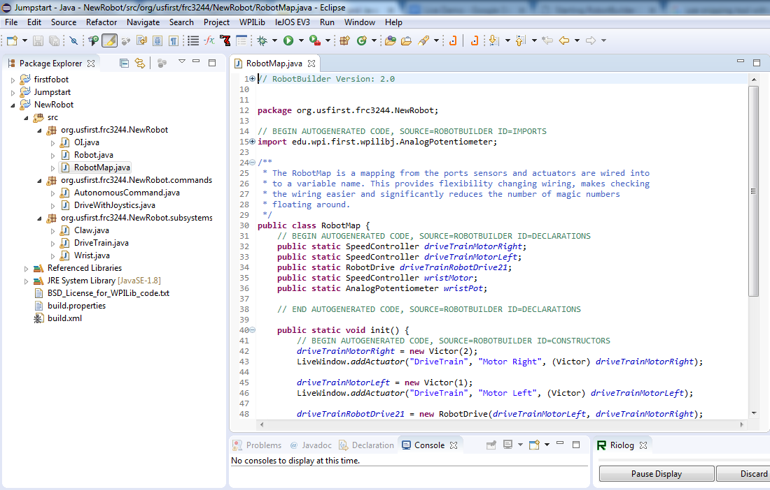
Robotbuilder & Command Based Robot
Live Demo
Imported Code
Imported Code nicely organized
NewRobot
NewRobot.Commands
NewRobot.Subsystems
In the classes there are comments like // BEGIN AUTOGENERATED CODE … ... // END AUTOGENERATED CODE These areas are code generated by Robotbuilder and will be overwritten each time we make changes in Robotbuilder.
Team 3244

Slide 26
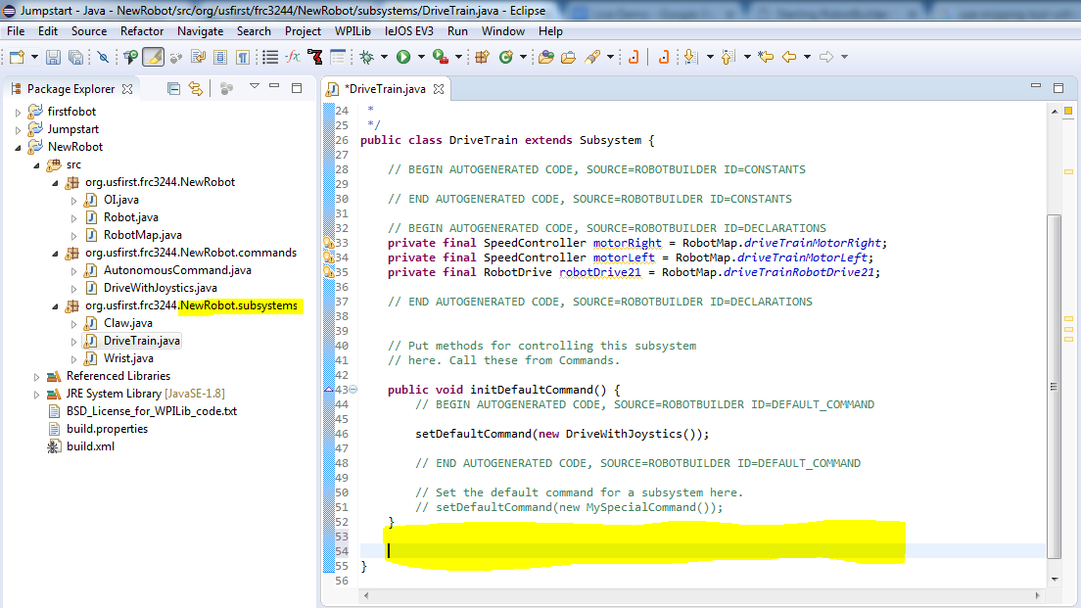
Robotbuilder & Command Based Robot
Live Demo
Subsystems
At the top are the objects available for this subsystem to control.
A Method created for us to set the default command
Highlighted area will be where we write our methods this subsystem can do, get, and set methods for Data.
Team 3244

Slide 27
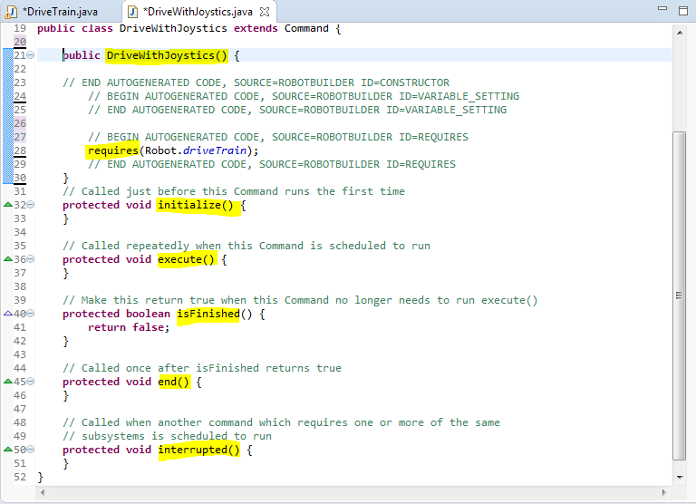
Robotbuilder & Command Based Robot
Live Demo
Commands
This will tell our Subsytems what to do.
Command Constructor Sets the Requires
initialize() Called just before this Command runs the first time
execute()Called repeatedly when this Command is scheduled to run
Most of our code will go here
isFinished()Make this return true when this Command no longer needs to run execute()
end()Called once after isFinished returns true
interrupted()Called when another command which requires one or more of the sam subsystems is scheduled to run
Team 3244

Slide 28
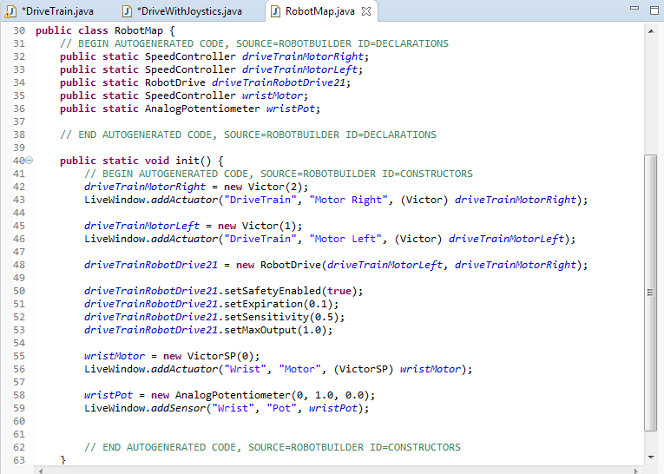
Robotbuilder & Command Based Robot
Live Demo
Robot Map
Container that maps the port numbers all PWM, DIO, Relay, Analog, and other components connected to the robot.
Team 3244

Slide 29
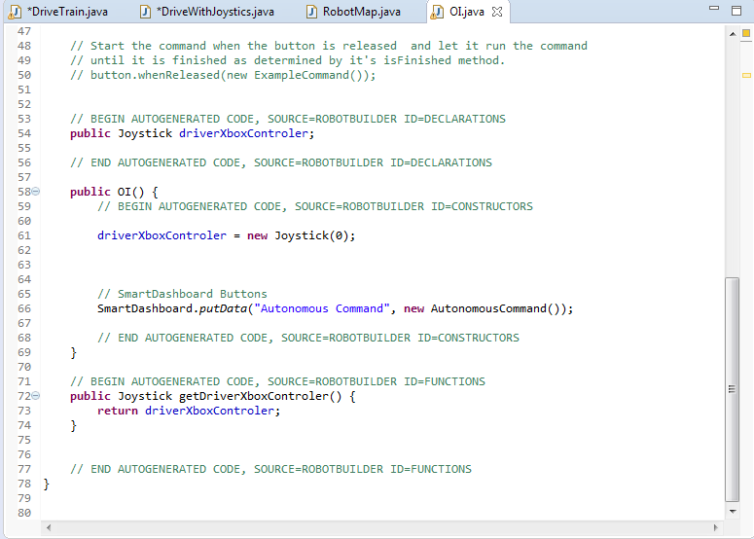
Robotbuilder & Command Based Robot
Live Demo
OI
Container that controls all the Operator Interface devices like Joysticks, Buttons, and SmartDashboard Buttons.
Team 3244

Slide 30
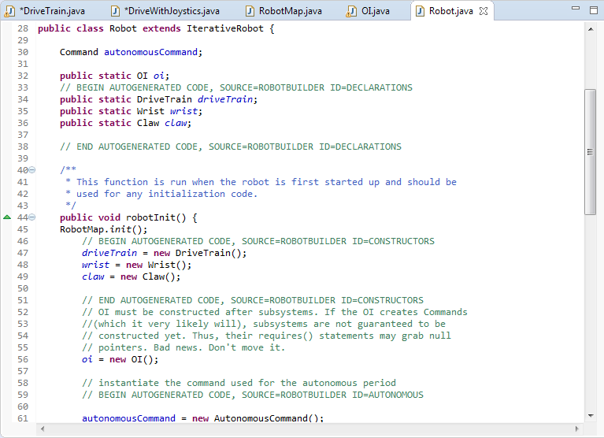
Robotbuilder & Command Based Robot
Live Demo
Robot
Container with everything related to the robot and the modes the robot will transition through when enabled. *Init runs once before Periodic runs
robotInit() initialization code
disabledInit(), disabledPeriodic() code run when robot disabled
autonomousInit(), autonomousPeriodic() code run when robot is autonomous
teleopInit(), teleopPeriodic() code run when robot is teleop
testPeriodic() code run when robot in testMode
Team 3244

Slide 31
Robotbuilder & Command Based Robot
Live Demo
Download Code to Robot *Test Mode
ToDo Test Mode
Team 3244

Slide 32
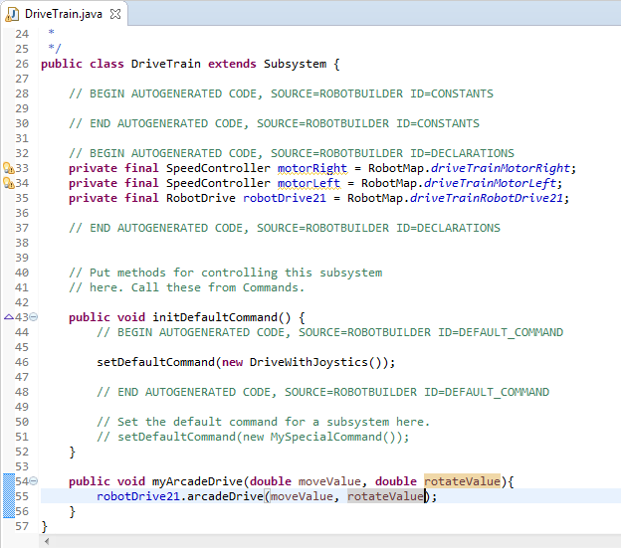
Robotbuilder & Command Based Robot
Live Demo
Code DriveTrain and Joysticks
Subsystem Code
Added Method “myArcadeDrive” This is the action this subsystem can do.
The method accepts two parameters to control the speed and direction of the robot
moveValue
rotateValue
Team 3244

Slide 33
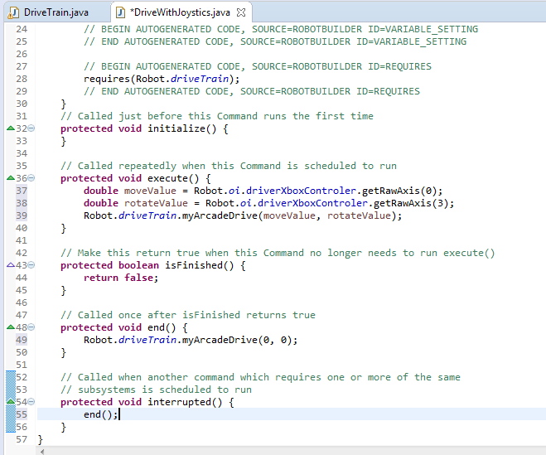
Robotbuilder & Command Based Robot
Live Demo
Code DriveTrain and Joysticks
Command Code
execute() Called repeatedly
two variables to store Joystick values from the Robot.oi
Send Joystick values to the Robot.driveTrain.myArcadeDrive method
isFinished() never complete
end()
Turn off motors if this command ends
interrupted()
Call end() if a new command requires driveTrain
Team 3244

Slide 34
Robotbuilder & Command Based Robot
Live Demo
Tune PID Using Test Mode
ToDo
Team 3244

Slide 35
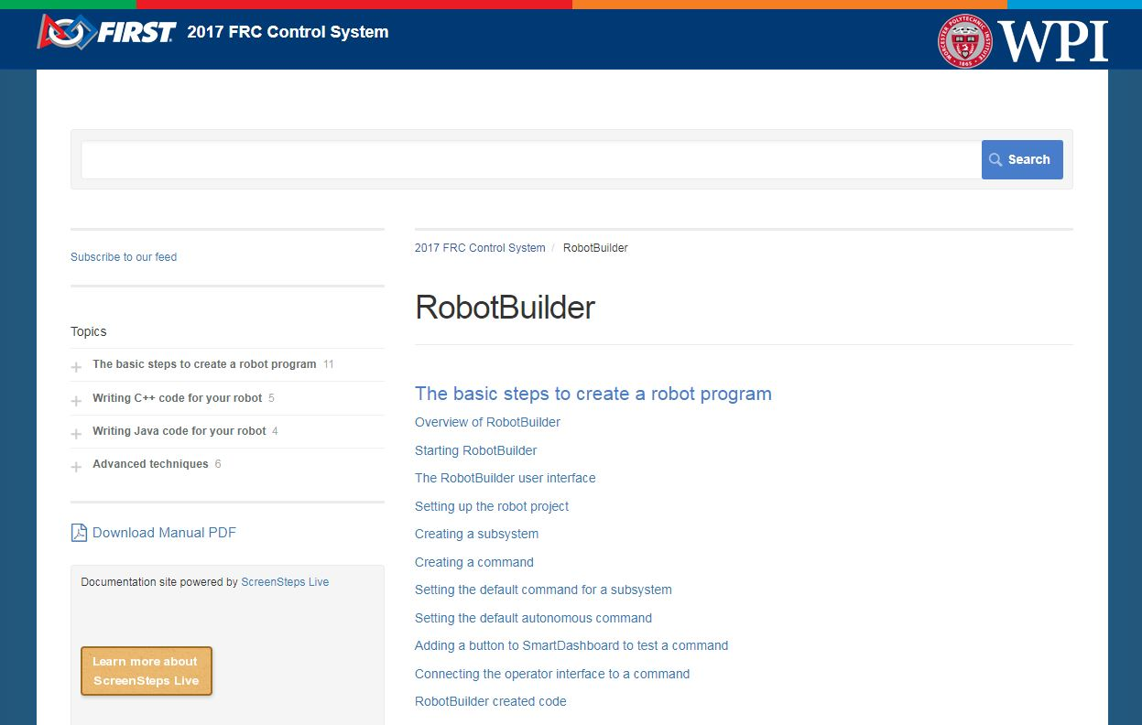
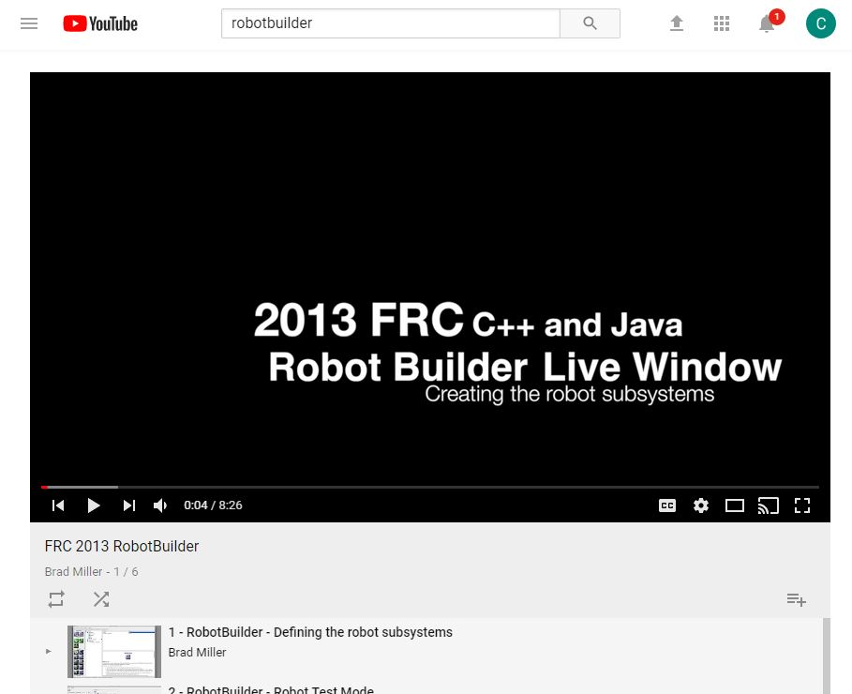
Robotbuilder & Command Based Robot
Find More Information on Robotbuilder
YouTube Brad Miller from WPI created 6 videos in 2013 that are still a great video series.
Search FRC 2013 Robotbuilder
Everyone should be familiar with
wpilib.screenstepslive.com
Team 3244

Slide 36
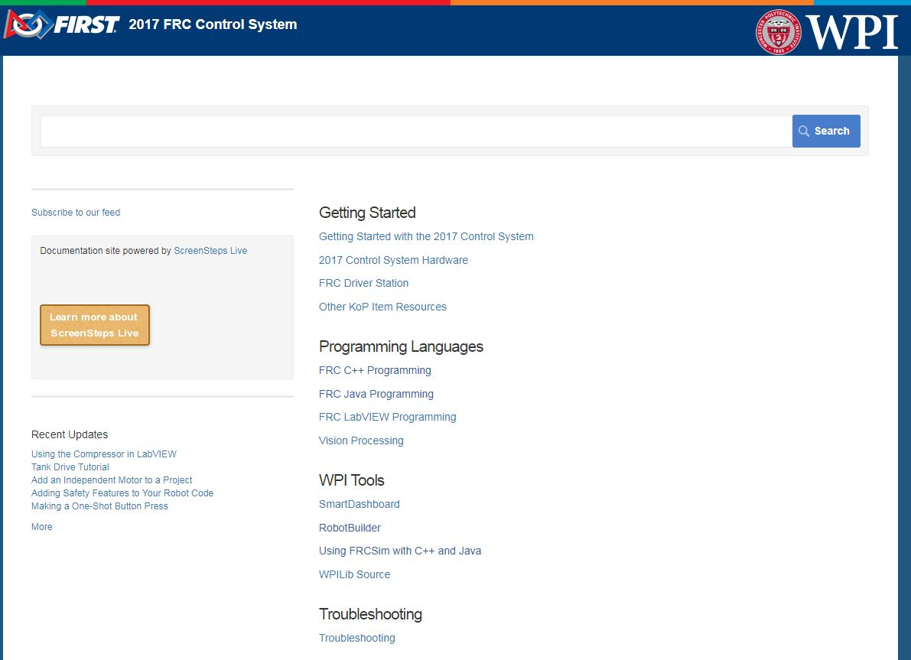
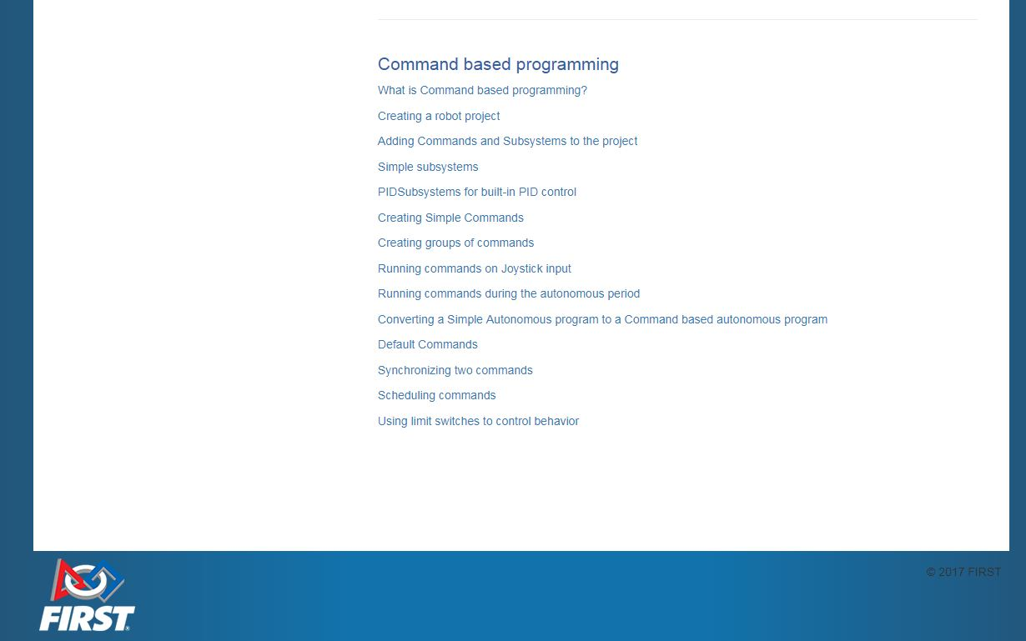
Robotbuilder & Command Based Robot
Find More Information On Command Based Programing
At the bottom of both the C++ and Java Programing Languages will be a Section for
Command Based Programing
Team 3244

Slide 37

Questions
Team 3244

